Slide 1
FUNT Controller
F.U.N. Team //Insert SpongeBob reference here
CE810-2

Slide 2
Using RHCA as the main algorithm of the controller
With some variations.
“Circular” buffer that takes into account the population of the last run.
New crossover functions
IVCrossover
TripleParentCrossover
UniformCrossover (in given code)

Slide 3
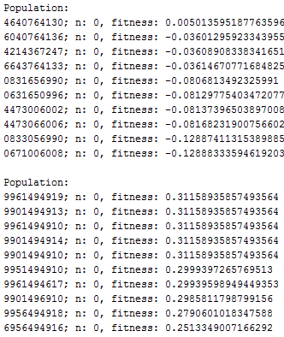
Before “circular” buffer
Every time a new action was required, the individuals actions will be initialized using a random function.
Why not taking into account the population of the last action?

Slide 4
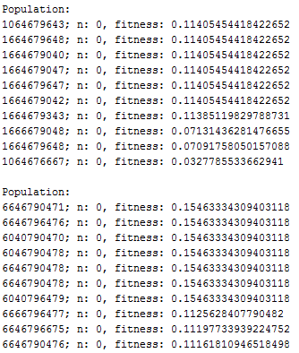
Circular buffer
The population is not initialized every time.
We now have HISTORY about the las action and fitness!
If an individual was [1,2,3,4,5,6,7,8,9,0] for the next action of the algorithm it will be: [2,3,4,5,6,7,8,9,0,RANDOM ACTION]. (The 1 was the past action taken by our controller, does not matter anymore.)

Slide 5
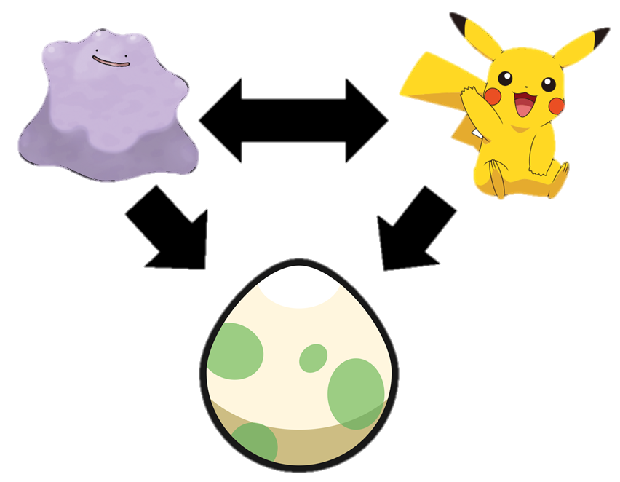
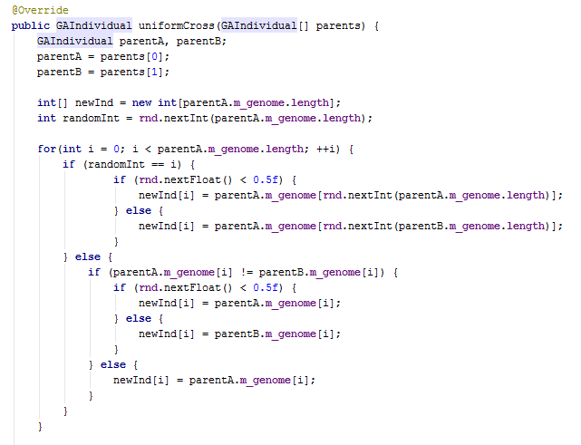
IVCrossover
Based on Pokemon IV breeding.
pA = 1011010100
pB = 1101001101
Ch = 1RR10RR10R
R = ParentA and ParentB genome have 50%.

Slide 6
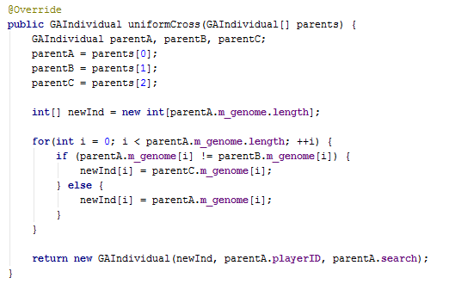
TripleParentCrossover
pA = 1011010100
pB = 1101001101
pC = 1010101010
Ch = 1011001100

Slide 7
Uniform vs IV vs TripleParent
Who will perform better?
Any bet?

Slide 8
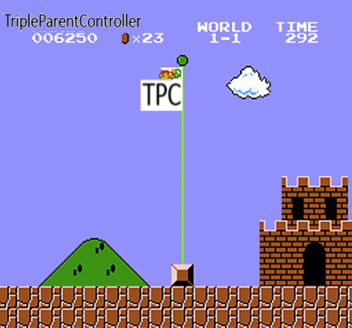

Slide 9
Results
 | TripleParent | IV | Uniform
TripleParent | - | 70% | 58%
IV | 29% | - | 37.5%
Uniform | 41.5% | 62% | -
%Wins

Slide 10
Outperforming RHCA, RHGA, OLMCTS…
Played 200 games against each controller using TripleParentCrossover.
VS | FUNT Wins | FUNT Win% | Ave. Ticks | Ave. Lives | Ave. Fire | Ave. Points
RHCA | 187 | 93.5% | 1145 | 3.085 | 63.87 | 58.65
RHGA | 193 | 96.5% | 911 | 3.515 | 51.065 | 59.3
FIREFOR | 198 | 99% | 894 | 4.78 | 49.67 | 60.05
RAS | 199 | 99.5% | 805 | 5.285 | 44.68 | 59.85
OLMCTS | 200 | 100% | 759 | 5.605 | 42.245 | 59.55
DETOLMCTS | 200 | 100% | 731 | 5.72 | 40.52 | 59.9

Slide 11
Versus other controllers at our home battlefield…
Played 200 games against each controller using TripleParentCrossover.
VS | FUNT Wins | FUNT Win% | Ave. Ticks | Ave. Lives | Ave. Fire | Ave. Points
PINK | 200 | 100% | 742 | 5.71 | 41.15 | 60.35
ARNIE | 200 | 100% | 893 | 4.56 | 49.685 | 59.95
IGGI3 | 200 | 100% | 753 | 5.72 | 41.69 | 60.25
CURLYSTRAIGHT | 197 | 98.5% | 1022 | 3.995 | 57.155 | 60.15

Slide 12
Tournament Score (10 games)
FUNT: 40.0 points
CURLY: 28.5 points
ARNIE: 20.5 points
PINK: 7.5 points
IGGI3: 3.5 points

